Slide 1
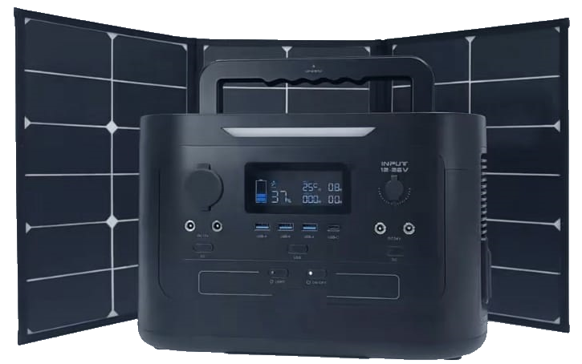
MOBILE ENERGY STORAGE, STORAGE AND CONVERSION SYSTEMS
LLC «AES»
Russian manufacturer of innovative equipment

Slide 2
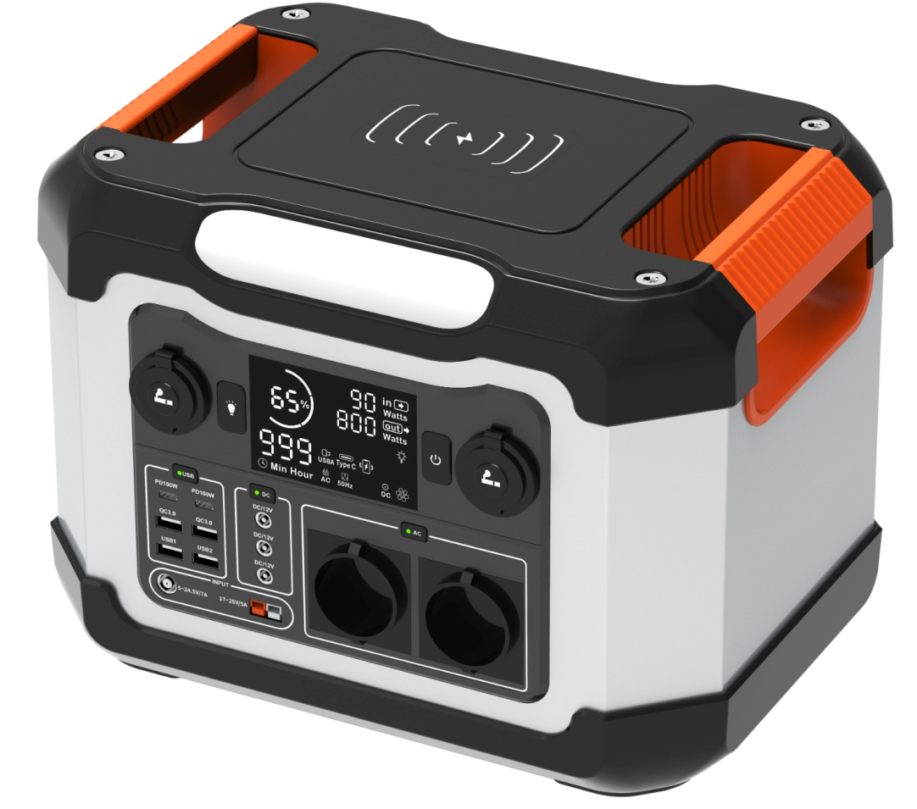
TECHNOLOGY OF ACCUMULATION AND STORAGE OF ELECTRICITY
Highly efficient advanced energy storages:
Lithium-ion batteries
High energy density and reliability
Presence of BMS on each cell
Possibility of charging from solar panels
The ability to work in UPS mode
Safety
The possibility of generating electricity anywhere!

Slide 3
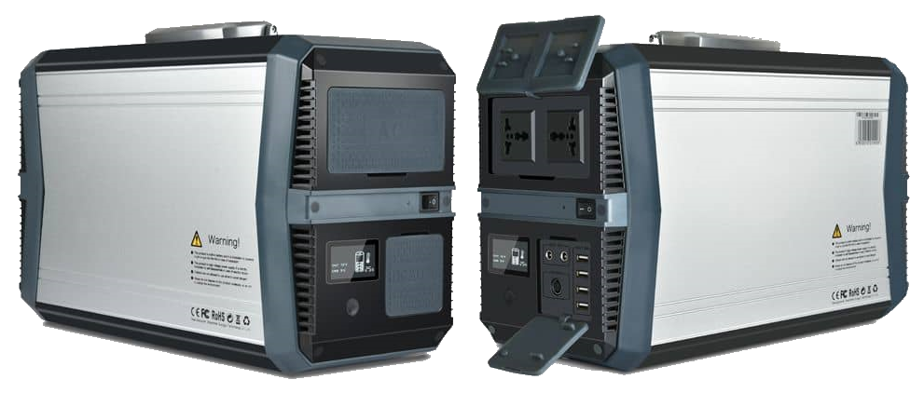
PERFOMANCE
The compact, mobile design of the storages is made of high-quality materials.
A large selection of standard connectors and interfaces for connecting external devices:
Output AC 220-230V
DC 12V output
USB-A output
USB-C output
Output DC24V
Input DC 5~28V
Input AC 220-230V (mains/generator)
DC18V solar panel support
Wireless charging
Spotlight and reading lamp (adjustable brightness)

Slide 4
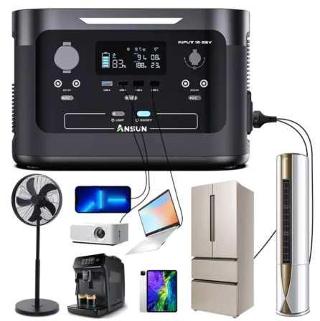
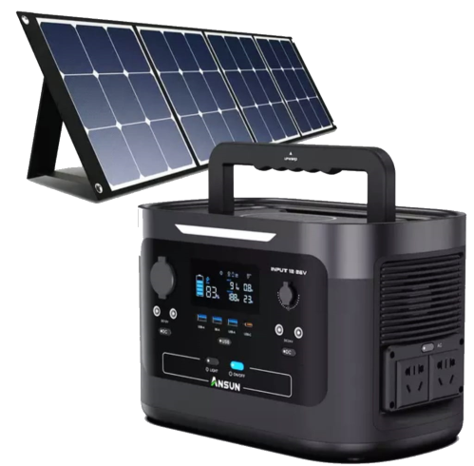
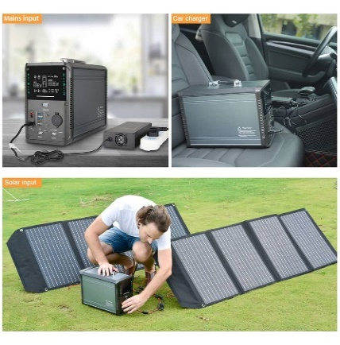
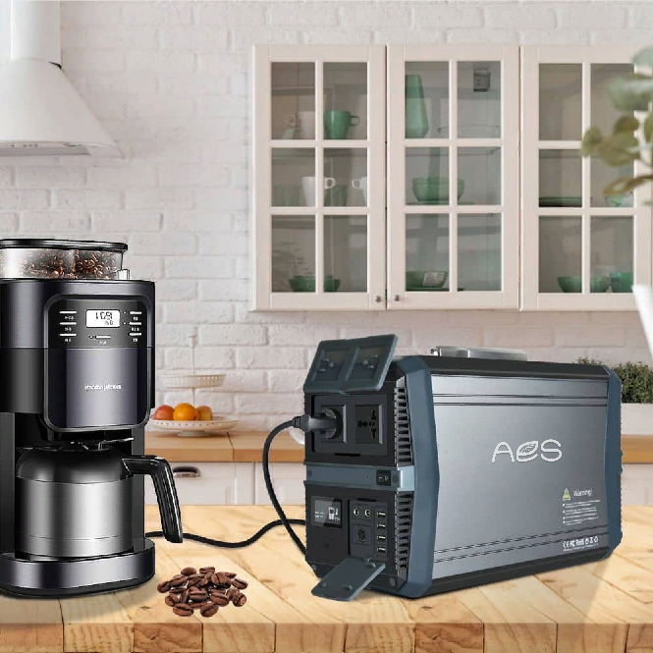
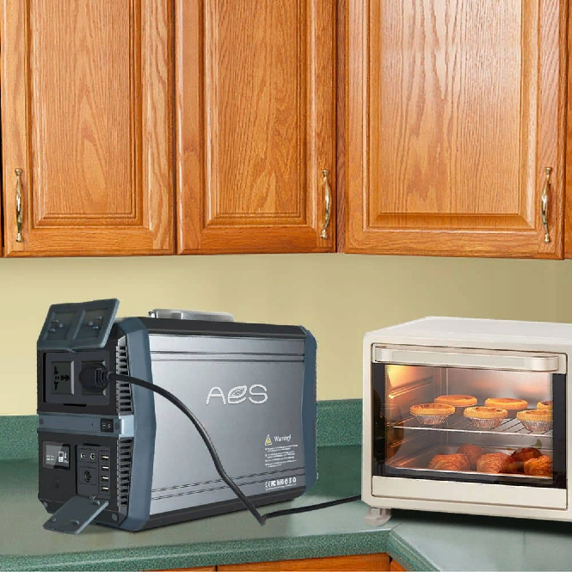
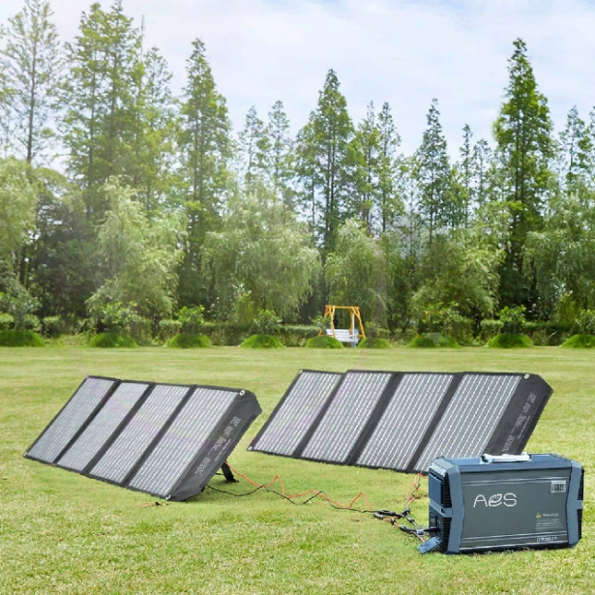
APPLICATION
The best solution as a reliable uninterruptible power supply (UPS) in domestic conditions, in nature and at business

Slide 5
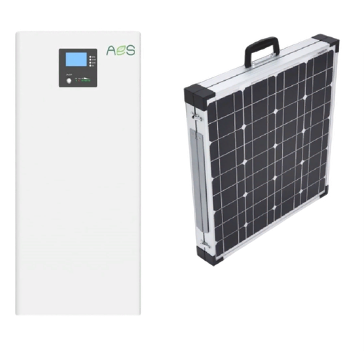
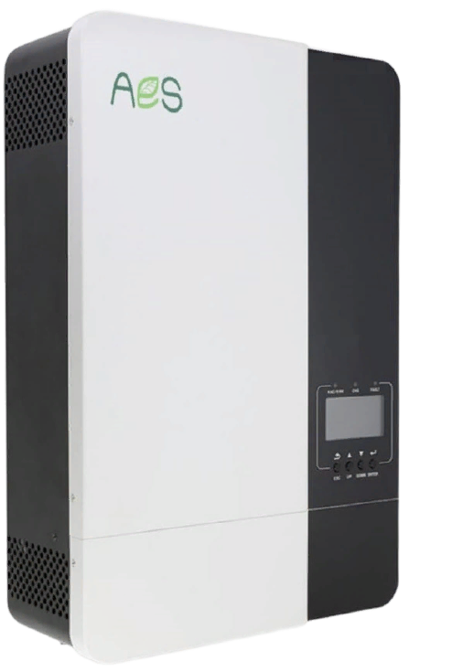
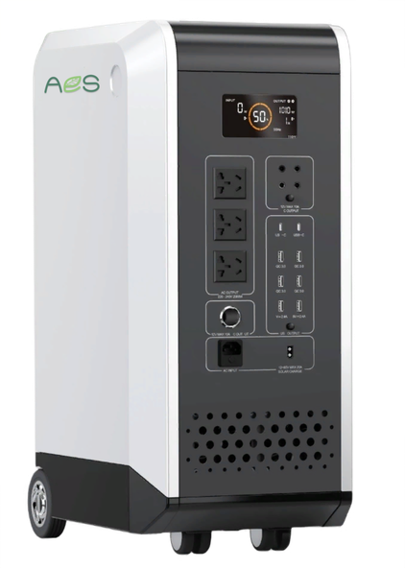
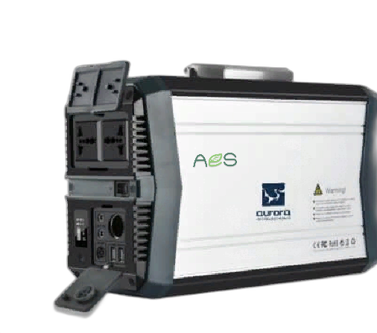
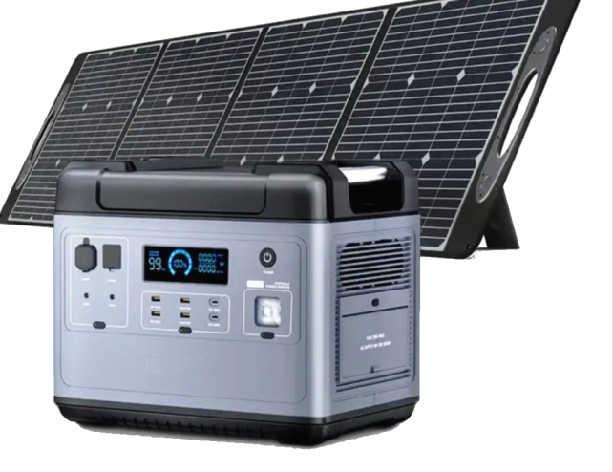
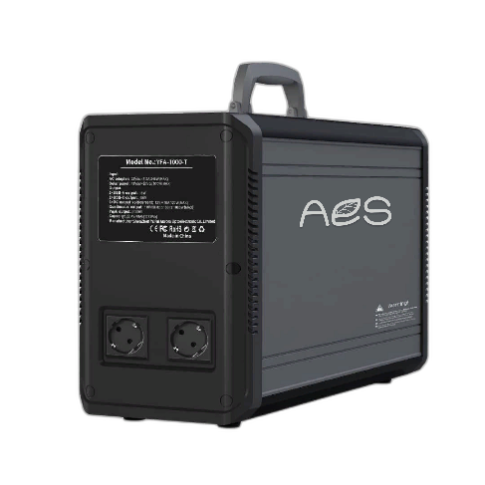
TECHNICAL SOLUTIONS

Slide 6
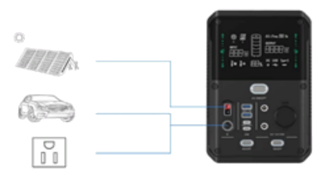
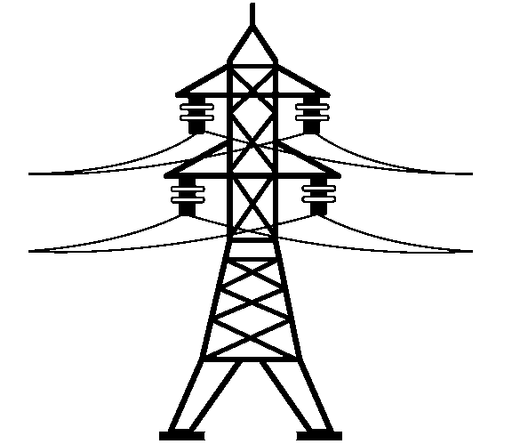
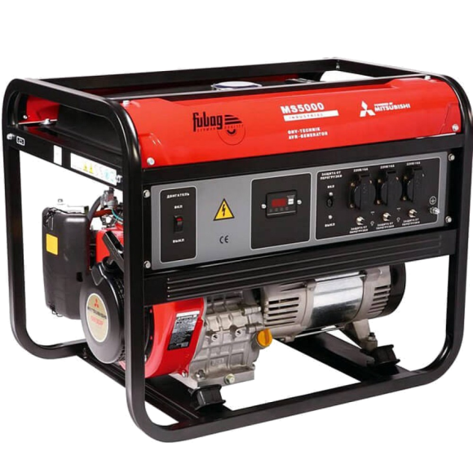
WAYS FOR CHARGING STORAGE DEVICES
As a power source (charging) can be used:
Solar panels (photovoltaic modules)
Automotive (on-board) network 12/24 V
220 V power grid (as well a gasoline and diesel generator)

Slide 7
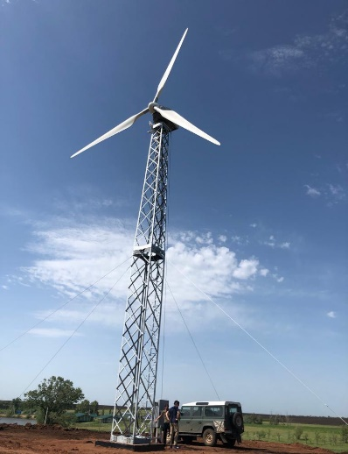
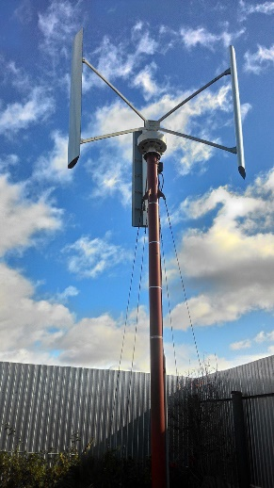
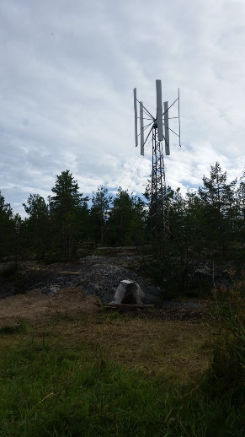
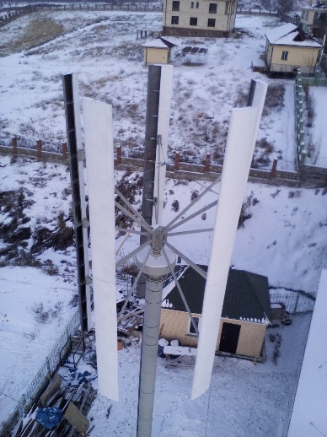
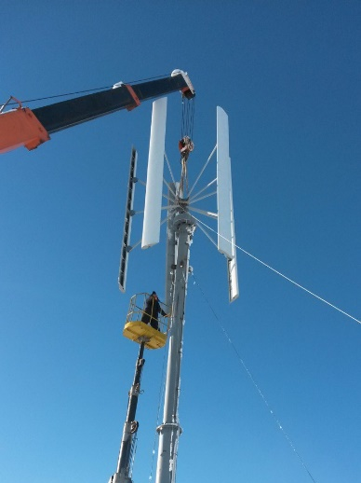
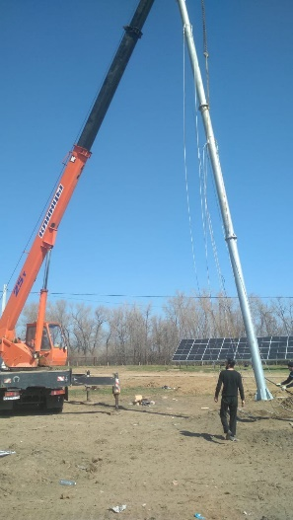
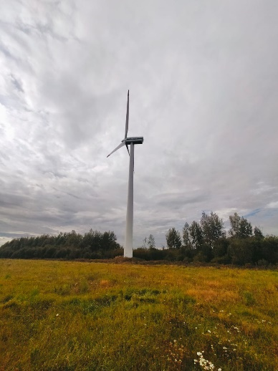
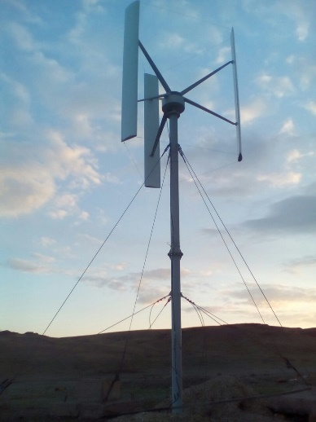
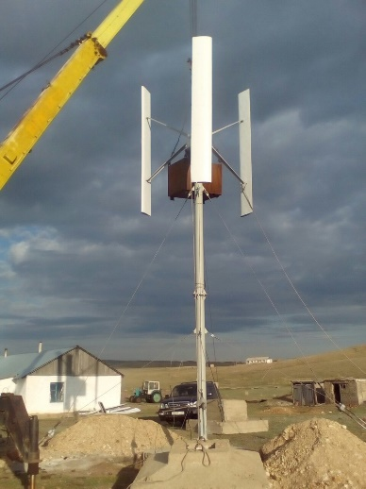
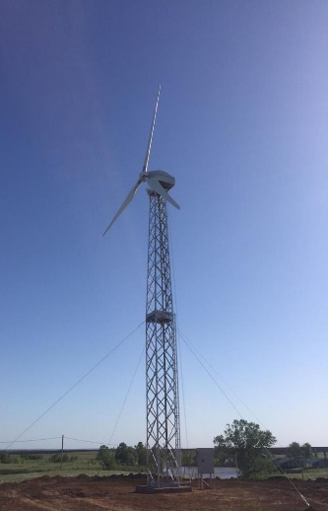
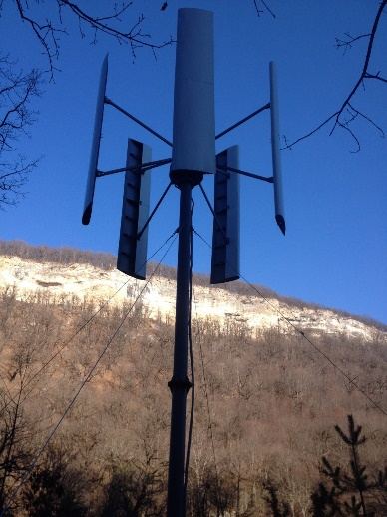
IMPLEMENTED PROJECTS

Slide 8
CONTACT INFORMATION
LLC «AES»
105203, Moscow, ext. ter. city of Vostochnoye Municipal District Izmailovo, 15th parkovaya str. , 5
https://aes-ltd.ru
email: info@aes-ltd.ru
aesilli@ya.ru
tel.: +7 (916) 758-18-37
Sincerely,
Illi Sergey
Director of the LLC «AES»

